Slide 1
Object Oriented Programming
Week 7
Abeer GAUHER
Email: abeer.gauher@nu.edu.pk
Office: CS BASEMENT 2, Office number 17

Slide 2
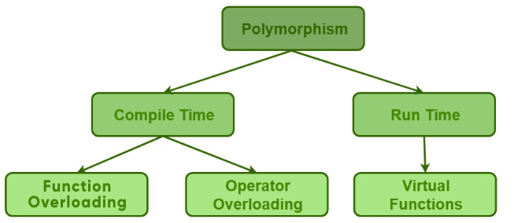
Polymorphism
Refers to the ability to associate multiple meanings to one function name.

Slide 3
Compile Time Polymorphism
The overloaded functions are invoked by matching the type and number of arguments.
This information is available at the compile time and, therefore, compiler selects the appropriate function at the compile time.
It is achieved by function overloading and operator overloading which is also known as static binding or early binding.

Slide 4
Function Overloading
C++ enables several functions of the same name to be defined, as long as they have different parameter signatures.
The compiler selects the proper function to call by examining the number, types and order of the arguments in the call.

Slide 5
Function Overloading
The return type or name of parameters don’t help the compiler in selecting which overloaded function to call.
Function Overloading can be done in two ways:
Either by using different types of arguments or a different number of arguments according to the requirement.
It is only through these differences compiler can differentiate between the two overloaded functions.

Slide 6
Example
void findPerson(string name) { . . . }
void findPerson(int ID) { . . . }
void findPerson(int ID, string addr) { . . . }
void findPerson(string addr, int ID) { . . . }
All of above are valid overloaded functions

Slide 7
Example
void showVal(int a)
{ cout << a; }
void showVal(char a)
{ cout << a; }
void showVal(float a)
{ cout << a; }
int main()
{
showVal(‘M’);
showVal(20);
showVal(3.5);
}

Slide 8
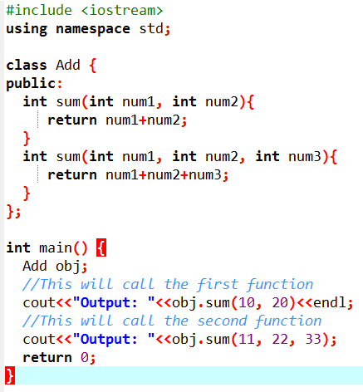
Example

Slide 9
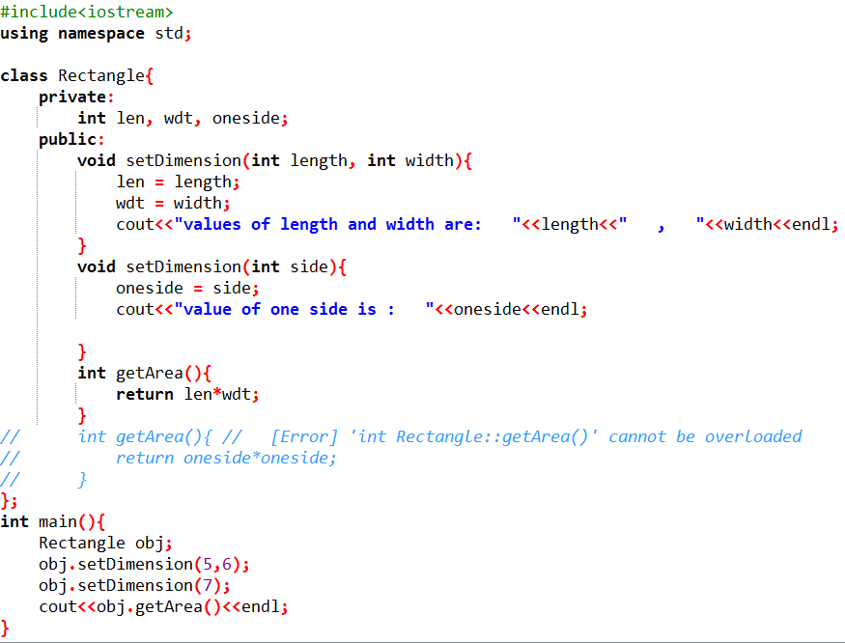

Example

Slide 10
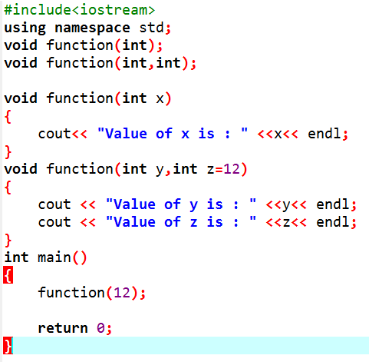
Function with default args
The above example gives an error saying “call of overloaded ‘fun(int)’ is ambiguous”, this is because function(int y, int z=12) can be called in two ways:
By calling the function with one argument (and it will automatically take the value of z = 12)
By calling the function with two arguments.
When we call the function: function(12) we full fill the condition of both function(int) and function(int, int), thus the compiler gets into an ambiguity shows an error.

Slide 11
Runtime Polymorphism
Run-time polymorphism takes place when functions are invoked during run time.
It is also known as dynamic binding or late binding.
Function overriding is used to achieve run-time polymorphism.
In contrast, to compile time polymorphism, the compiler decides the object at run time and then decides which function call to bind to the object.
Function overriding cannot be done within a class. The function is overridden in the derived class only. Hence inheritance should be present for function overriding.
The function from a base class that we are overriding should have the same signature or prototype i.e. it should have the same name, same return type and same argument list.

Slide 12
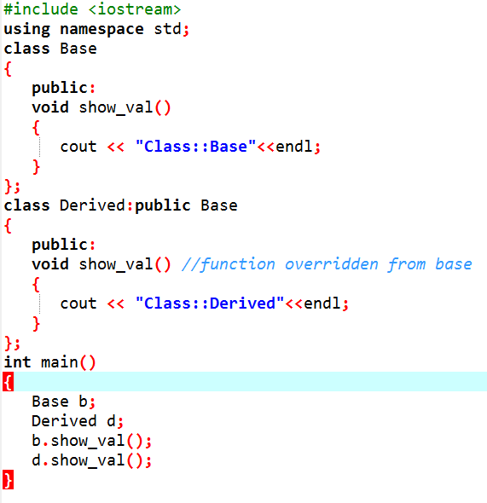

Runtime Polymorphism (Example)

Slide 13
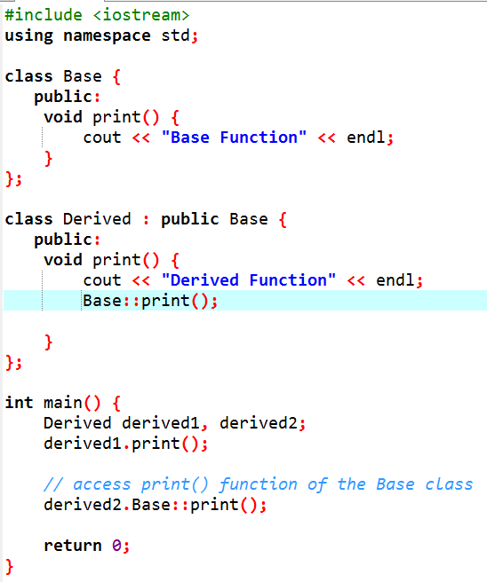

Runtime Polymorphism (Example)
To access the overridden function of the base class, we use the scope resolution operator ::.

Slide 14
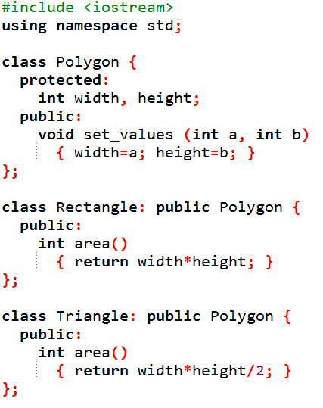
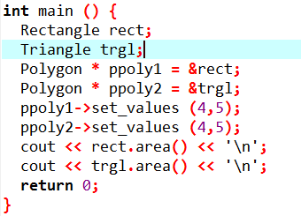

Example

Slide 15
Example
Function main declares two pointers to Polygon (ppoly1 and ppoly2). These are assigned the addresses of rect and trgl,, which are objects of type Rectangle and Triangle.
Such assignments are valid, since both Rectangle and Triangle are classes derived from Polygon.
Dereferencing ppoly1 and ppoly2 (with ppoly1-> and ppoly2->) is valid and allows us to access the members of their pointed objects.
But because the type of both ppoly1 and ppoly2 is pointer to Polygon (and not pointer to Rectangle nor pointer to Triangle), only the members inherited from Polygon can be accessed, and not those of the derived classes Rectangle and Triangle.
The program accesses the area members of both objects using rect and trgl directly, instead of the pointers; the pointers to the base class cannot access the area members.
Member area could have been accessed with the pointers to Polygon if area were a member of Polygon instead of a member of its derived classes, but the problem is that Rectangle and Triangle implement different versions of area, therefore there is not a single common version that could be implemented in the base class.

Slide 16
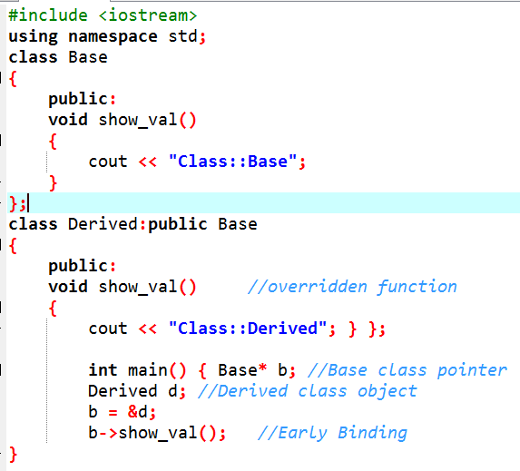
Runtime Polymorphism (Example)
The output is “Class:: Base”. So irrespective of what type object the base pointer is holding, the program outputs the contents of the function of the class whose base pointer is the type of.
In this case, also static linking is carried out.
In order to make the base pointer output, correct contents and proper linking, we go for dynamic binding of functions.
This is achieved using Virtual functions mechanism

Slide 17
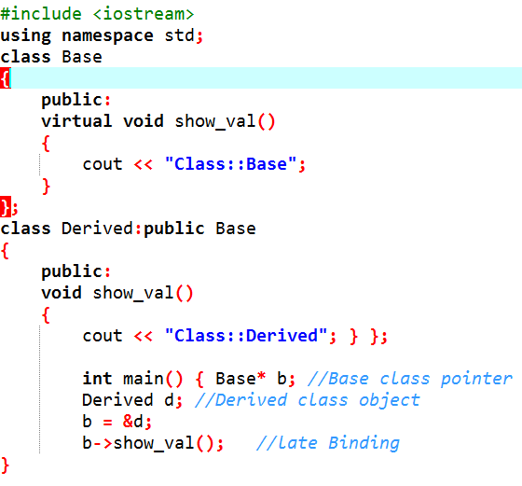
Runtime Polymorphism (Example)
For the overridden function should be bound dynamically to the function body, we make the base class function virtual using the “virtual” keyword.
This virtual function is a function that is overridden in the derived class and the compiler carries out late or dynamic binding for this function.
If a function is declared virtual in the base class, then it will be virtual in all of the derived classes.

Slide 18
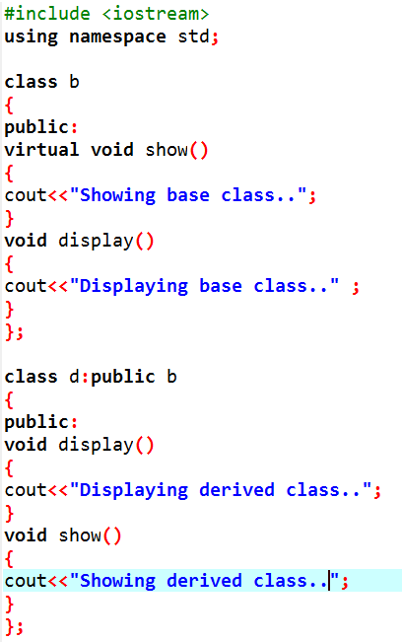
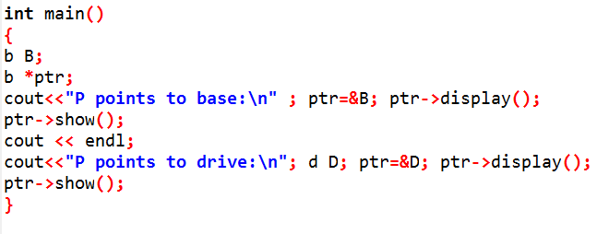

Runtime Polymorphism (Example)

Slide 19
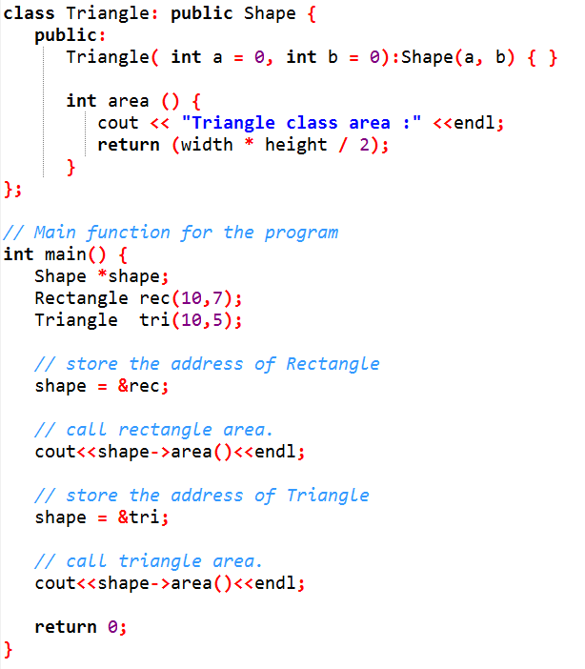

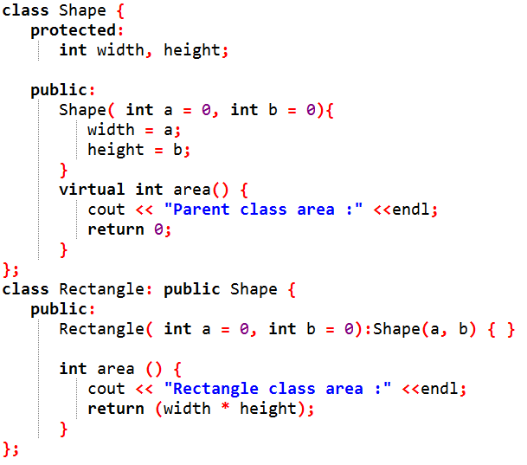
Runtime Polymorphism (Example)

